Slide 1
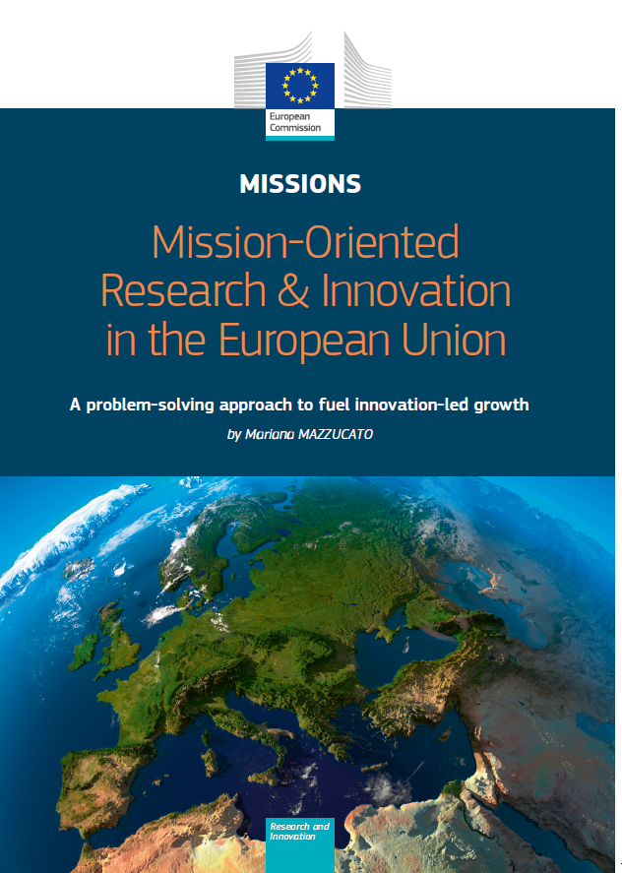
A “mission” on nutrients in HorizonEurope?
EU Commission (COM) is now preparing FP9 (HorizonEurope)
→ R&D funding programme for 2021-2028
→ will follow on from Horizon2020
→ announced budget c. 100 billion €
→ FP9 Regulation proposal published 7/6/18
COM proposes to include “Missions” (art. 5)
→ cross-disciplinary
→ across/within FP9 R&D themes/challenges
“Small number” of missions over whole of FP9
→ up to 10 year duration
→ COM examples: fight against cancer,
clean transport, plastic-free oceans
→ “Mission Boards” (15 persons, high level)

Slide 2
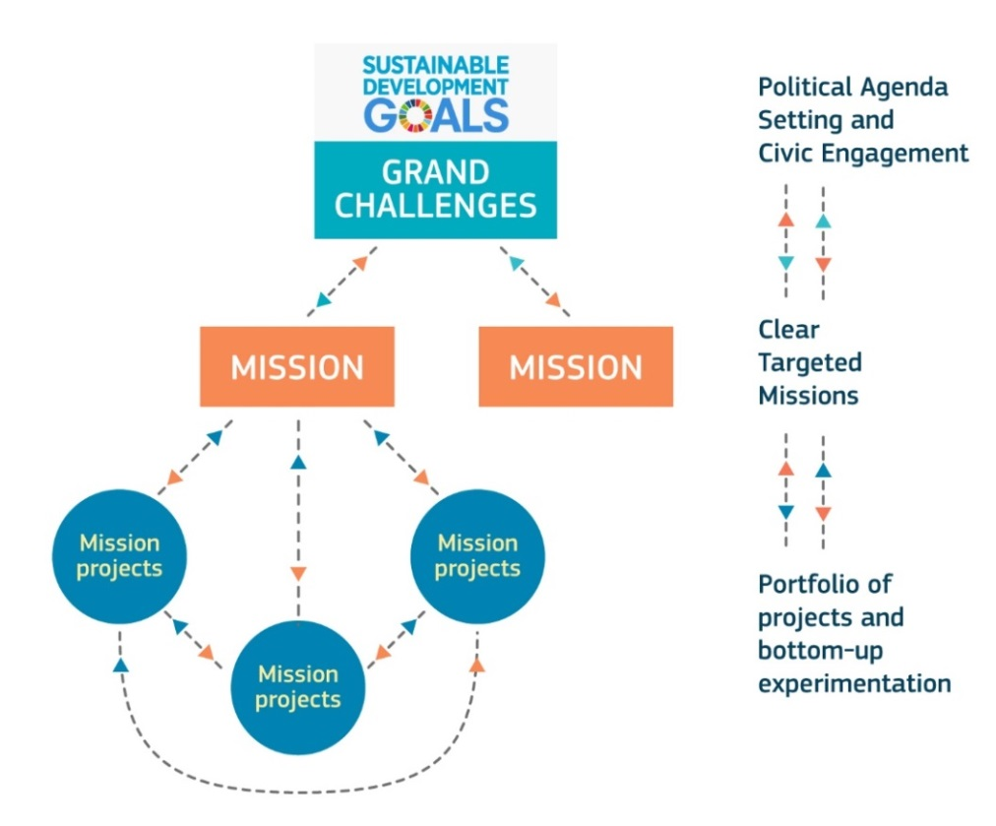
A “mission” on nutrients in HorizonEurope?
COM DG Research stakeholder meeting 30th May (with ESPP, SYSTEMIC)
→ COM invites to suggest outline for a mission on “nutrients”
→ input collected by International Nitrogen Initiative inms@ceh.ac.uk
→ ESPP to propose first pooled version, after discussion at ESPC3
Process for input & for selection of “missions”
not yet defined
But objective =
input to COM by Sept. 2018
Discussion of vision, content,
to propose a “Mission” on nutrients
→ today 17h30 in this room

Slide 3
“Missions” in FP9 Horizon Europe proposal 7/6/18
FP9 regulation proposal published 7/6/18 http://europa.eu/rapid/press-release_IP-18-4041_en.htm
and https://ec.europa.eu/info/designing-next-research-and-innovation-framework-programme/what-shapes-next-framework-programme_en
Pillar 2 – Global Challenges
& Industrial Competitiveness
Health
Inclusive and Secure Society
Digital and Industry
Climate, energy and Mobility
Food & Natural Resources
→ “Missions” = across and within these themes

Slide 4
Criteria for “Missions” in FP9 HorizonEurope
Bold, inspirational
with wide societal relevance
A clear direction:
targeted, measurable and time-bound
Ambitious but realistic
research and innovation actions
Cross-disciplinary, cross-sectoral,
cross-actor
Multiple, bottom-up solutions
Mazzucato report on R&D “Missions”, see
https://ec.europa.eu/info/designing-next-framework-programme/mission-oriented-policy-next-research-and-innovation-framework-programme_en
and summary https://t.co/wAb5gNmBqB

Slide 5
A “mission” on nutrients in Horizon Europe?
Objective = input to European Commission by Sept. 2018
→ ideas for content & vision of a “mission” on nutrients
Contributions from 30th May meeting (DG RTD, SYSTEMIC, ESPP)
→ you can still input – send one page to inms@ceh.ac.uk
OBJECTIVE NOW
- progress a nutrients “mission” proposal
- vision, content, stakeholders to engage
Coherence with: OPF Scientists Call, current H2020 and other R&D,
national nutrient research agendas, support for EU policies
Perhaps not lead to a “nutrients” mission
→ content will input to other missions or themes

